Slide 1

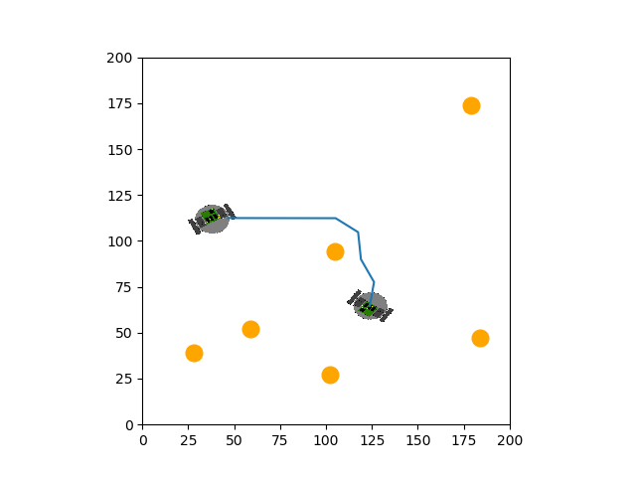
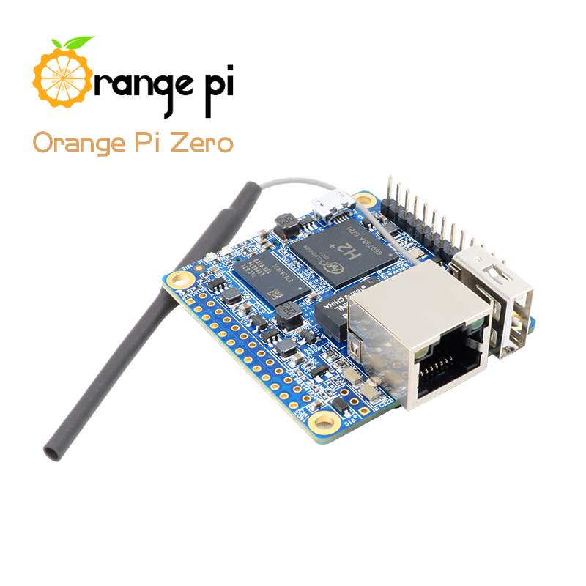
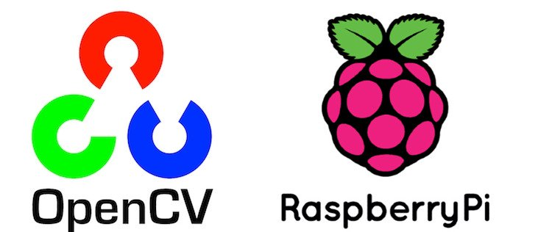
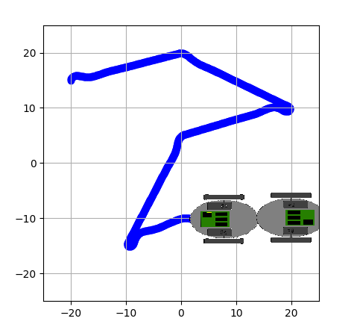
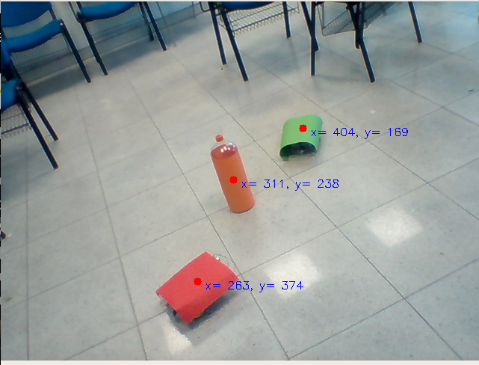
FLAG RACING WITH GLOBAL CAMERA SYSTEM
Burak Han Demirbilek & Selahattin Çağdaş Akalın
Hande Yıldırım & Batu Kaan Özen
Department of Electrical and Electronics Engineering
TOBB University of Economics and Technology
ABSTRACT
The main goal of this project is to create four robotic systems that can carry a flag in hurdle area. The basic working principle of these systems is to detect robots and obstacles at a certain height with a camera located out of the platform and to establish routes by color selection. With the routes calculated, we will establish a map for carrying the flag to another robot. The technical process of the Project is mainly based on the Image Processing, Embedded Systems, Robotics, artificial Intelligence and Control Systems.
TECHNICAL SPECIFICATIONS
There are 4 important parts for this project. These are :
1. Brain Module
2. Communication Module
3. Movement Module
4. Flag Changing Module
Generally, Python was used for coding RaspberryPi 3B+ and OrangePi Zero.[2][3]
Figure 2 : Path planning
COMMUNICATION MODULE
Reliable data and message transfer using TCP packets
Responsible for communicating with the brain(Raspberry Pi) and the controller.
MOVEMENT MODULE
Path tracking with remotely operated PID controller
Modelling the robot and simulating the PID controller
Movement simulation with using mathematical model of the Differential Drive robot.
BRAIN MODULE
Robot localization(finding location and direction) with object detection by using color filtering and contour detection
Smooth path planning with A* search algorithm by using custom Heuristic function
Figure 3 : Differential Drive Robot simulation results of the PID controller
FLAG CHANCING MODULE
Used a metal plate as a flag.
Changing the flag by using electromagnetic module.
CONCLUSION
In this project, we designed 4 robotics which can carry a metal plate to each other autonomously by using Python.
Figure 1 : Detection of the angles and color of our obstacles
PYTHON – RASPBERRY PI – ORANGE PI
Used Python programming interface to program our controllers.
Used OpenCV for image processing.
Implemented the code for A* algorithm and PID controller for movement module.
Used RaspberryPi for our Brain module.
Used OrangePi Zero for our Movement module.
REFERENCES
https://docs.opencv.org/3.0beta/doc/py_tutorials/py_imgproc/py_morphological_ops/py_morphological_ops.html
https://wiki.python.org/moin/UdpCommunication
https://thepihut.com/blogs/raspberry-pi-tutorials/27968772-turning-on-an-led-with-yourraspberry-pis-gpio-pins
https://www.pythonforbeginners.com/dictionary/python-split

